Slide 1
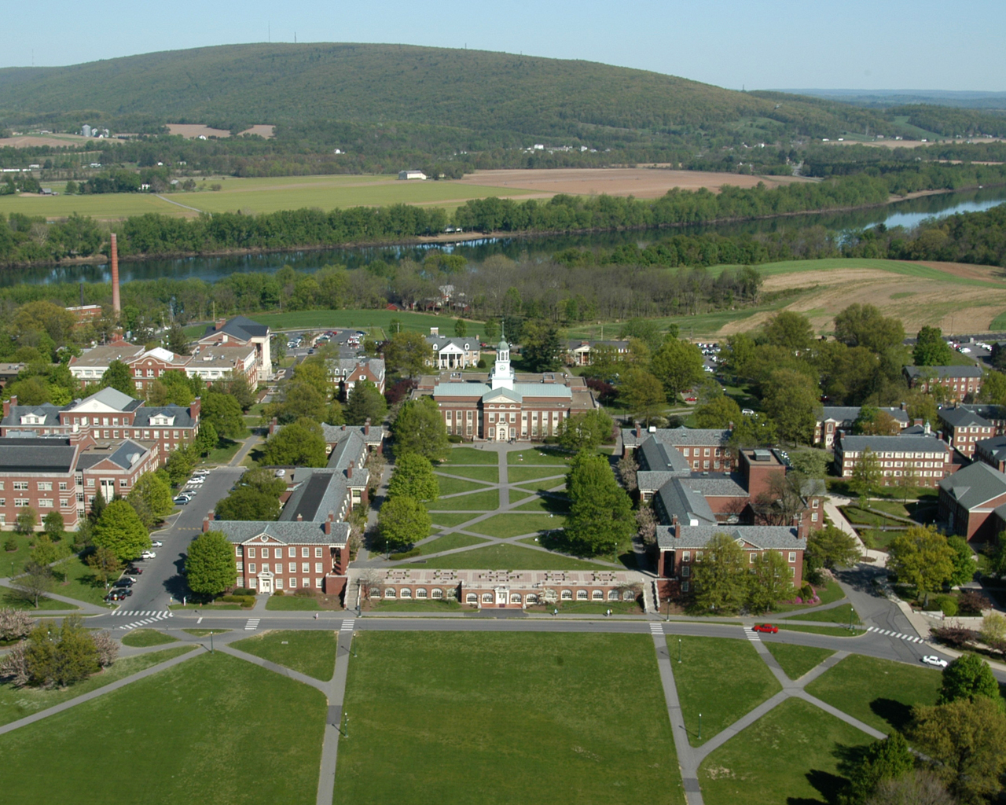



Bucknell University
International Orientation 2011

